Slide 1
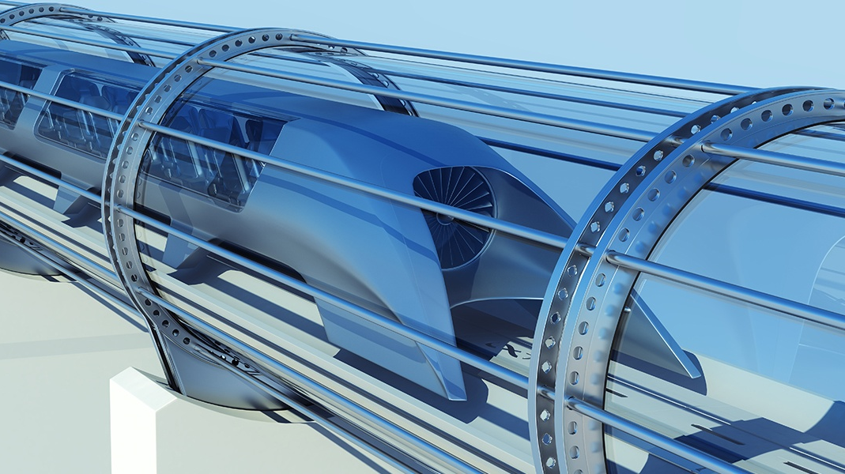

3rd Chief Minister’s Governance Lecture
All Aboard:
The Journey of High Speed Rail to Canberra
DR MICHAEL EASSON
FRICS FAICD AM, Chair, City Renewal Authority (CRA) of the ACT

Slide 2
CANBERRA AND TRAINS GO BACK TO OUR EARLIEST DAYS
Politicians in the early years of federation travelled by train and available vehicles to Dalgety, Bombala, Tumut and Canberra, looking for the ‘ideal spot’ for the national capital.
We’re off – it is a special train
For Capitals we’re looking
For many days, through
Devious ways
And variegated cooking
Each hill and dale, each stream and lake
Seems all the more alluring,
When sandwiches and bottled ale
Alleviate our touring.
(Anonymous verse, published in Table Talk in 1902, quoted in Paul Daley, Canberra, New South, 2012, p. 127)
Page 2

Slide 3
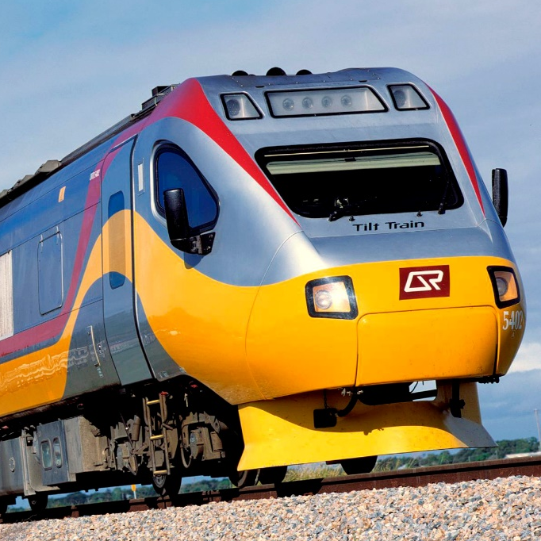
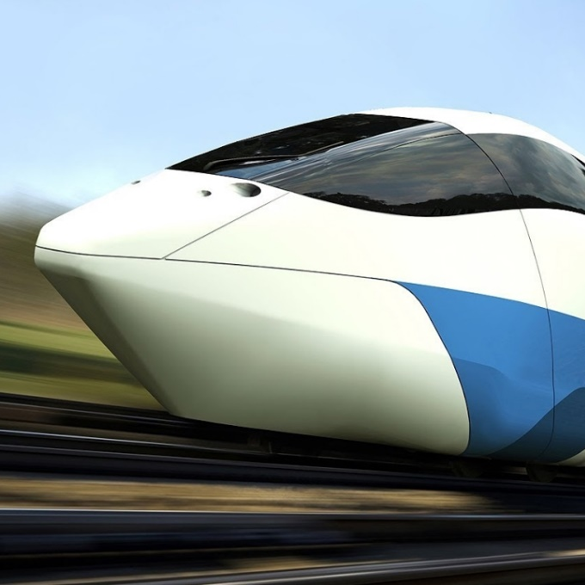
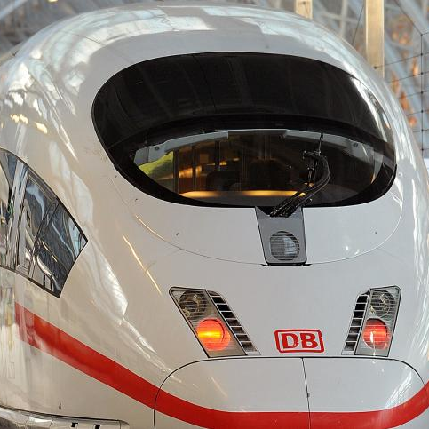
A VISIT TO THE ARCHIVES
Discovered furious debates in the late 1980s and early 1990s about different types of train technology
TILT
MAGLEV
ICE
Page 3

Slide 4
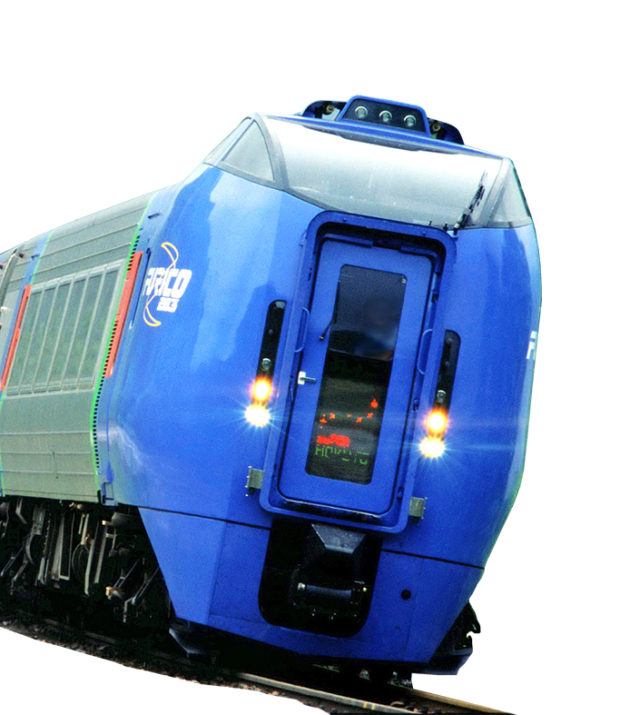
TILT
A tilting train is a train that has a mechanism enabling increased speed on regular rail tracks. As a train (or other vehicle) rounds a curve at speed, objects inside the train experience inertia. Due to centrifugal force, this can cause packages to slide about or seated passengers to feel squashed by the outboard armrest. If you are standing you can easily lose your balance. Tilting trains are designed to counteract this discomfort. In a curve to the left, the train tilts to the left to compensate for the g-force push to the right, and vice versa. The train may be constructed such that inertial forces cause the tilting (passive tilt), or it may have a computer-controlled power mechanism (active tilt).
A high-speed tilting train is a tilting train that operates at high speed, typically defined as by the European Union to include 200 km/h (124 mph) for upgraded track and 250 km/h (155 mph) or faster for new track.
Tilting trains operating at 200 km/h (124 mph) or more on upgraded track include the Acela in the US, the X 2000 in Sweden, certain lines in the UK (the Pendolinos, Super Voyagers and the West Coast Main Line, as well as the ICE TD in Germany (the latter two being diesel powered).
Page 4

Slide 5
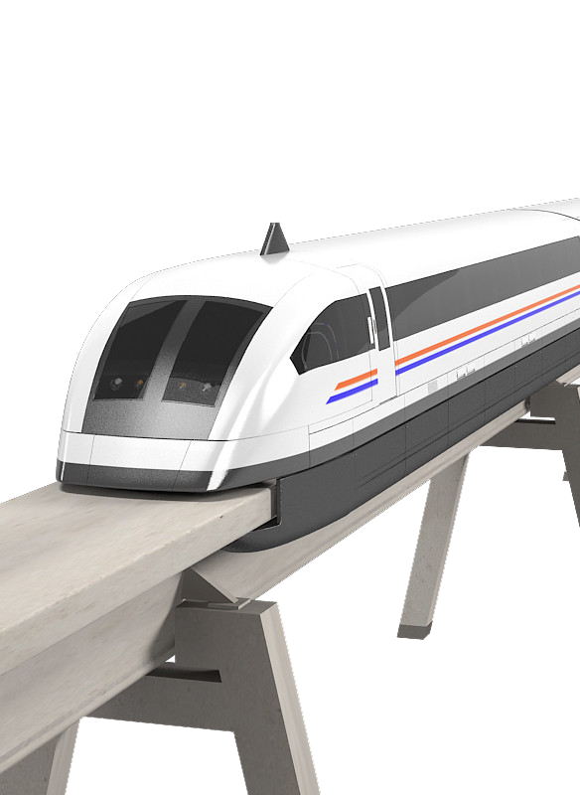
MAGLEV
The name is derived from magnetic levitation) is a system of train transportation that uses two sets of magnets, one set to repel and push the train up off the track as in levitation (hence Maglev, Magnetic-levitation), then another set to move the “floating train’ ahead at great speed taking advantage of no friction.
Page 5

Slide 6
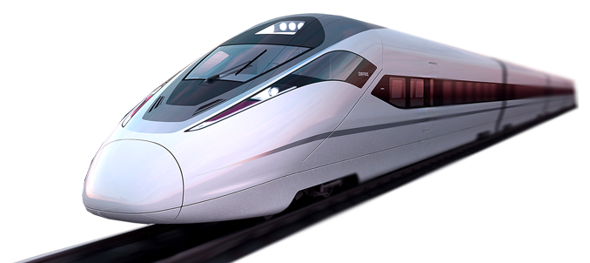
ICE
The Intercity-Express or ICE is a system of high-speed trains predominantly running in Germany and its surrounding countries
Page 6

Slide 7
ACT VHST EVALUATION STUDY - A CLASH OF STRATEGIES
In particular, consideration should be given to what technologies might be most appropriate so that the problems of state by state rail development in the past are not repeated. One example cited was the differences in rail gauges between the states which led to passengers having to change trains when they reached the NSW/Victorian border. A National policy is required so that we do not end up with a similar situation in regard to VHST, eg travelling from Brisbane to Sydney on a Maglev train, changing to a TGV for the Speedrail run to Canberra, and then changing to an ICE train for the journey to Melbourne. Another issue is tying all VHST development to a particular technology (eg, TGV) solely because it is the first entrant into the marketplace.
Each of the three governments so far involved in the analysis of the Speedrail proposal has its own strategic position regarding the proposal and on rail development in general. This “strategic” difference has not been placed on the table for consideration/analysis or for development of overall strategic coherence.
VHST Evaluation Study. Government and Legal Issues, 25 May 1996, Records from File no. 96/12931 - Very High Speed Train, ACT Government Services - Strategic Programs Division, p. 7.
Page 7

Slide 8
THE CATCH 22 SITUATION
Without a specific proposal (such as the VFT or Speedrail) to provide an incentive to develop a policy framework within a defined timeframe, any policy development is likely to be slow, if it occurs at all. However, once such a proposal comes forward (and, realistically, such a proposal would have to come outside of government), the time taken to develop a national policy response may well be greater than the decision-making timeframe of the proposal. A Catch 22 situation.
VHST Evaluation Study. Government and Legal Issues, 25 May 1996, Records from File no. 96/12931 - Very High Speed Train, ACT Government Services - Strategic Programs Division, p. 9.
Page 8

Slide 9

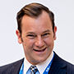

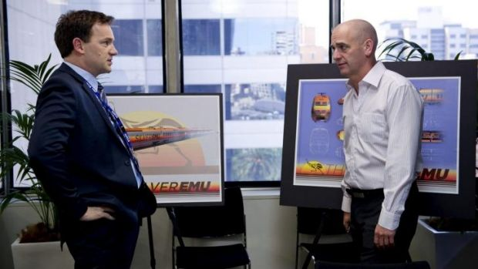
THE SILVER EMU PROBLEM
Off to Canberra: Jim (Anthony Lehmann) and Tony (Rob Sitch) discuss the very fast train option in episode three of Utopia.
RHONDA
I don’t understand why you’re being so negative. I’ve been doing this job for over 20 years and trust me – every time we announce a Very Fast Train, 95 per cent of Australians are for it.
TONY
And the other five percent?
RHONDA
Who are they?
TONY
Engineers, economists, experts in transport logistics...
RHONDA
Yeah, yeah. The lunatic fringe. Real people love it. So where are we at?
Photo: Hwa Goh
TONY
Well we’re trying to secure the rail corridor between Sydney, Brisbane, Melbourne because if you want to build this thing…
Page 9

Slide 10
MORE FROM UTOPIA
Well, here we go. As it turns out the first feasibility study into a Very Fast Train was done in 1982.
SCOTT
Think they might have done a scoping study.
SCOTT
TONY
What’s the difference?
TONY
And what did that find?
SCOTT
One’s thicker.
SCOTT
That it wasn’t feasible.
HUGH
It’s got graphs and diagrams.
HUGH
But in 1990, a more detailed study was done.
I mean studies and scoping exercises. Have we ever got past that stage?
TONY
TONY
Oh. What did that find?
SCOTT & HUGH
Ahh... no.
SCOTT
That it definitely wasn’t feasible.
Right…
TONY
TONY
Right, so we can’t do a feasibility study.
SCOTT
No, ‘cause there’s another one being done right now.
The Very Fast Turnover, Series 1, Episode 3: 27 August 2014
TONY
You’re kidding me. Another one?
HUGH
Will be interesting to see what they find.
SCOTT
Absolutely
TONY
But I mean have we ever got past a feasibility study?
Page 10

Slide 11
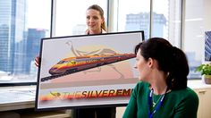
ONE THING THEY GOT RIGHT WAS NEED TO IDENTIFY THE CORRIDOR
TONY
If we’re going to make any headway with this crazy idea, our starting point has to be identifying the rail corridor…
Page 11

Slide 12
WHAT HAS CHANGED IN 25 YEARS?
Still a debate about alignment, the route, the cost, the cost split between State & Federal governments & the private sector.
China has built 20,000km of high speed rail in this period
Air Travel Easier
Population Growth
The project needs champions at the federal political level – a John Sharp or Anthony Albanese – to make the most ambitious project work.
Costings now $140B plus
Page 12

Slide 13
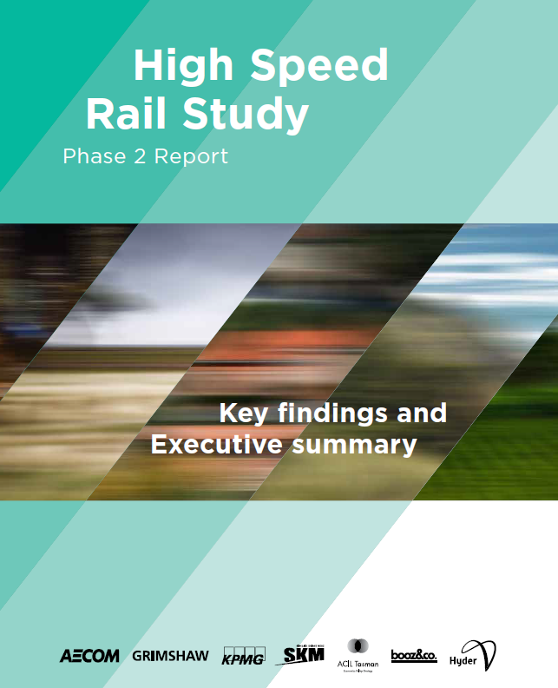
Page 13

Slide 14
AECOM ET. AL. REPORT
Most comprehensive report was the High Speed Rail Rail Study Phase 2 Report by AECOM and others
Risk adjusted cost of 114.0Billion
Stage 1: Sydney-Canberra 283kms @ $23.0Billion
Stage 2: Canberra-Melbourne 611kms @ 26.9Billion
Page 14

Slide 15
PREFERRED ROUTE
Page 15

Slide 16
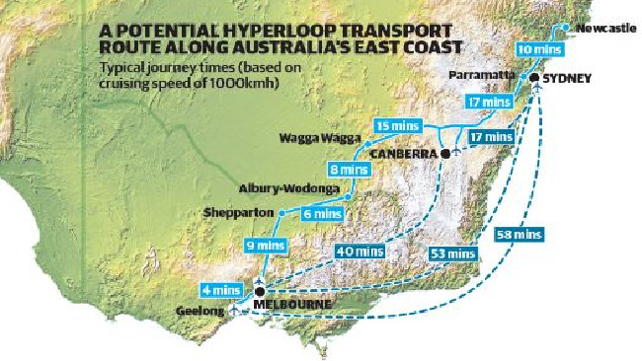
THE HYPER LOOP
Page 16

Slide 17
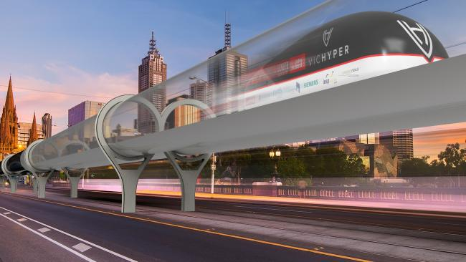
AN ARTIST'S IMPRESSION OF THE HYPERLOOP POD ON PRINCES BRIDGE, MELBOURNE.
Page 17

Slide 18
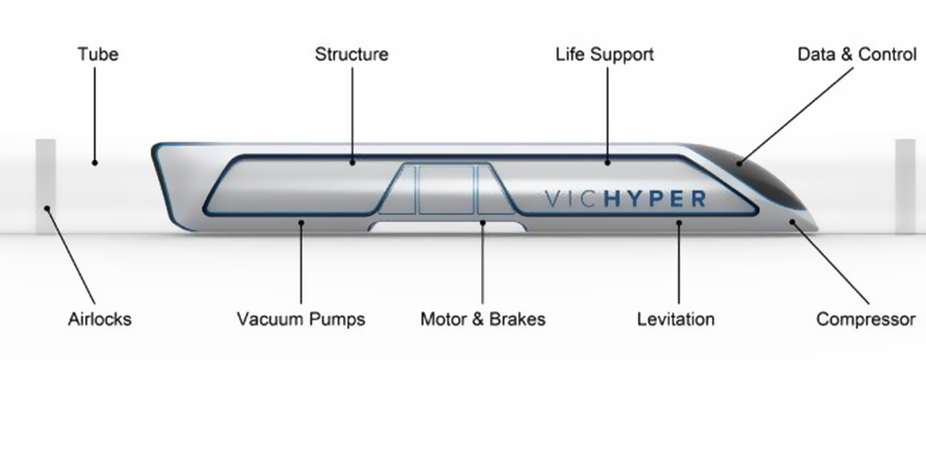
DIAGRAM OF THE HYPERLOOP POD. HOW IT WORKS
Page 18

Slide 19
CLARA Plan
Page 19

Slide 20
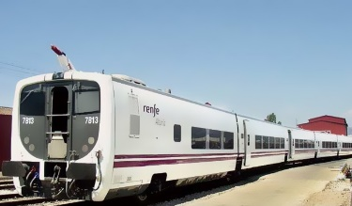
TALGO
Spanish company Talgo want to run their state of the art trains (pictured) between Canberra and Sydney so as to halve the current four-hour rail journey between Canberra and Sydney.
Run on the existing tracks between the two cities with little to no modification needed to railway infrastructure.
The full proposal would cost less than $100 million, according to them.
Page 20

Slide 21
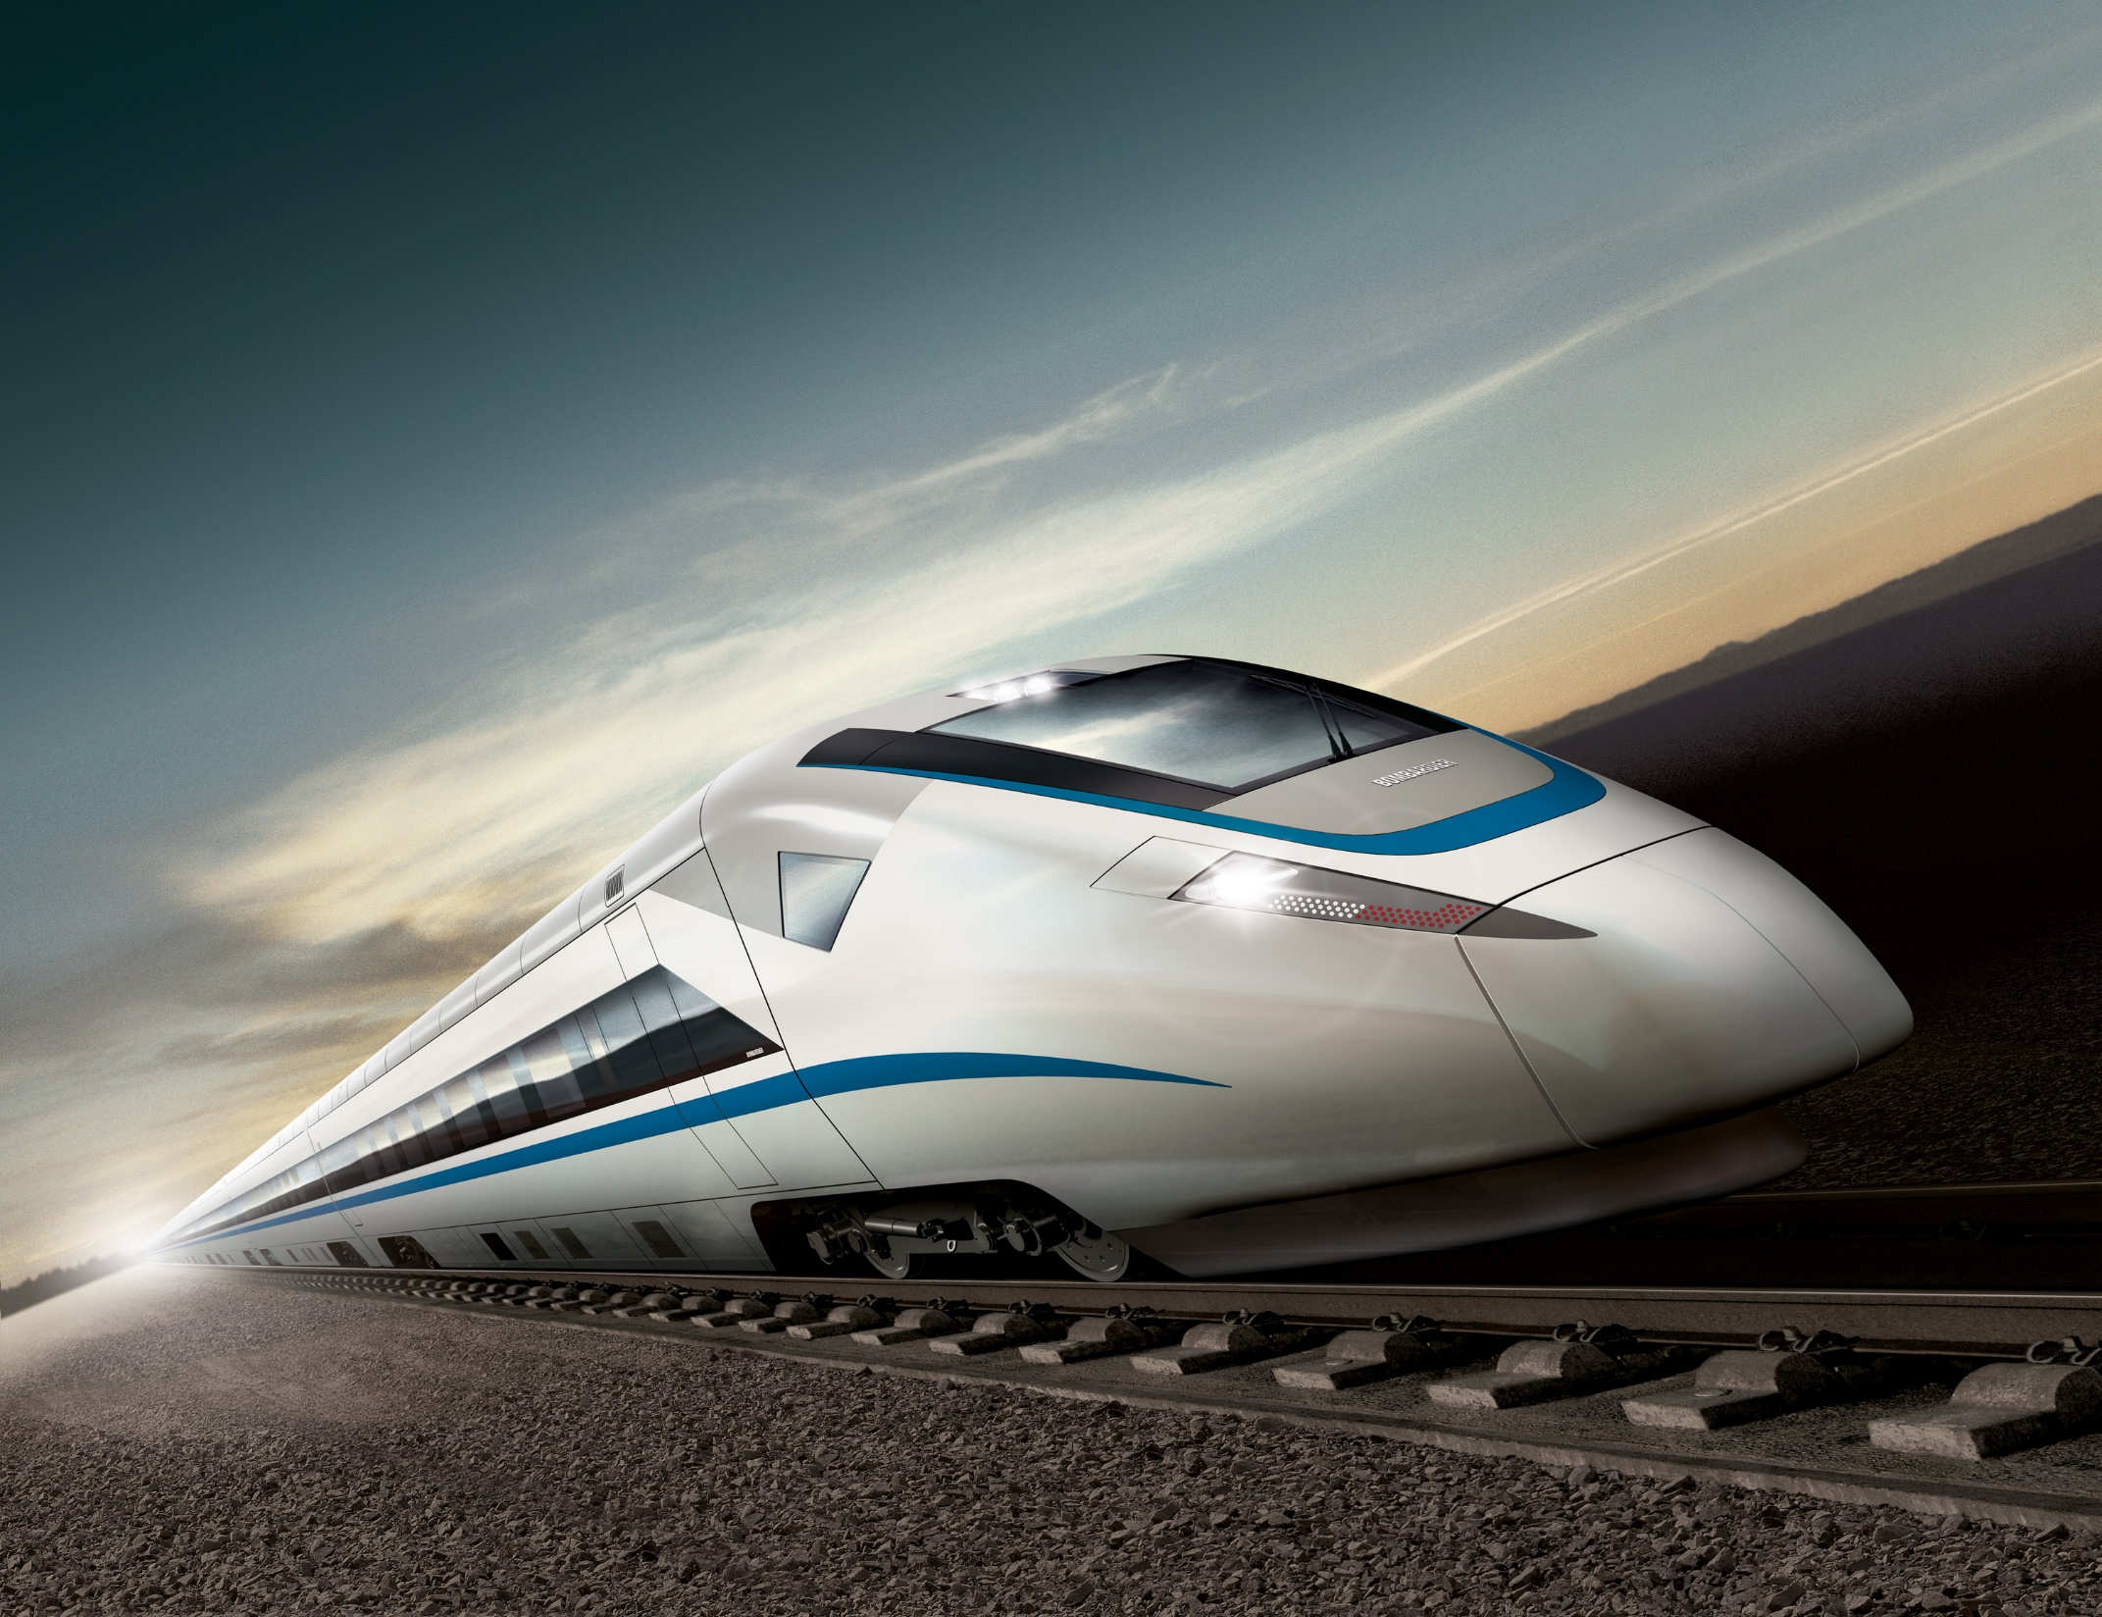
ZERO CARBON AUSTRALIA HIGH SPEED RAIL

Slide 22
ROUTE
Page 22

Slide 23
ACT GOVERNMENT PRIORITIES
Aviation – key priority – with the ACT government CM and Ministers meeting with airlines, created stimulus funds and done significant economic modelling to address failures in airlines existing data:
Singapore Airlines landed just over a year ago
Qatar commences international flights in Feb
Cathay have rumoured CBR as their next destination
Significant increase in domestic low cost carriers – still nothing on the Sydney route priced exclusively for business travel
Priority is an Auckland flight (AirNZ/ Virgin) for greater access to North America and NZ
Cancellation issue here
The ACT is in a chicken and egg phase with airport freight, we have carriers that need freight for long term viability but not enough carriers to already have an established freight forwarder, without a freight forwarder the airport isn’t too keen to make the significant investments in airside infrastructure. ACT continues to work with industry and NSW Government on this.
Rail
Internal: Light Rail & Buses
Bigger Picture: Faster Rail to Sydney & Melbourne?
Page 23

Slide 24
FASTER RAIL VERSUS HIGH SPEED RAIL
!
Fear is that High Speed Rail focus has detracted attention on here and now, improvements in existing alignments, etc.
ACT government needs to do what’s achievable and be ready for the big project, if it ever happens.
Start by doing what is necessary; then do what’s possible; and suddenly you are doing the impossible. - St. Francis of Assisi
!
!
Page 24

Slide 25
CONSIDER OPTIONS FOR FASTER RAIL:
Small-scale improvements, including minor track works and station improvements
Medium-scale improvements, such as minor corridor deviations including curb easing and track slews, new and/or upgraded stations, and new rolling stock;
Large-scale improvements such as major corridor deviations to eliminate steep or slow sections of track
Joint government initiative, Commonwealth, NSW, ACT on what needs to be done, route alignment, planning. Avoid the Catch 22.
Spending $200 to $500m might be better than the chimera of a $25.0b project to at least get the journey to 2.5 to 3 hours and have many positive impacts.
Page 25
Page 24

Slide 26
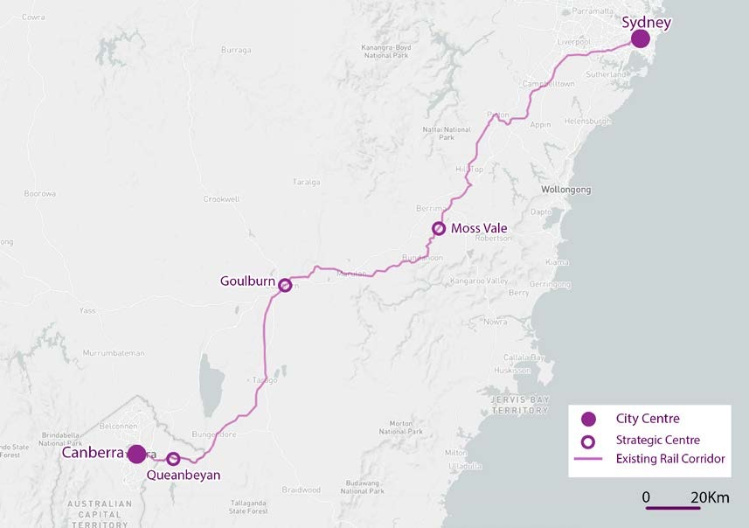
MAP OF EXISTING CORRIDOR
Page 26

